Slide 1

Software Assurance
Project Proposal
-By Team 7

Slide 2
Magento2 Github: https://github.com/magento/magento2
Open-source, enterprise-class eCommerce platform
100,000+ merchants worldwide
Acquired by Adobe Inc in May 2018
Magento2 is an open-source eCommerce R&D project
facilitating the improvement of Magento Core products.
Offers more functionality to merchants and continue to grow with the platform
100,000+ online stores have been created on this platform and 1,000 stores come online every day
These merchants depend on third-party developers to build Magento implementations, customizations, and extensions
Regarding Popularity
Accounts for 12% of all ecommerce sites Or 1.9% of the CMS market
Around $155 billion worth of goods have been sold in 2019
Two years ago, Magento has accounted for about 30% of the total market share

Slide 3
Small Business
Magento is ideal for fast-growing small businesses
Customizable, agile
it gives flexibility to small businesses
Affordable with Cloud hosting
eliminates the costs of maintaining, monitoring and hosting an eCommerce solution
thereby reducing total cost of ownership
Limitless - evolves as business grows and changes over time
Manage multiple stores, transacts in multiple countries, languages, currencies, and use several worldwide shipping providers, all within a single instance
Leverages Magento’s large Extensions Marketplace to add rich feature/capabilities and enable integrations with your other digital tools (e.g. ERP, CRM)
Enables merchants to sell customizable products and digital goods online

Slide 4
Magento Commerce for B2B
Enables merchants to handle the complexities of B2B commerce
Company accounts with multiple buyers in tiered organizational structures.
Self-service tools to manage buyer roles and permissions.
Full order, quote, and invoice tracking for buyers across the company.
Automated order approval process based on rules set by each company.
Friction-Free Purchasing
Quick order forms and list uploads for buyers who know exactly what they want
Saved shopping lists to make repeat purchasing even easier
Fast reordering from previous orders with just a couple of clicks
Agility to Adapt
Best-in-class B2B and B2C commerce in one platform to serve any audience
Mobile-optimized sites to enable field-based sales and purchasing
Amazon channel management for seamless selling on the world’s largest marketplace

Slide 5

Top Users
Nearly 7,500 customers have migrated to Magento from OpenCart and VirtueMart last year
Liverpool FC
Pepe Jeans
Land Rover
Harvey Nichols
Ford
Omega Watches
Christian Louboutin
Bulgari

Slide 6
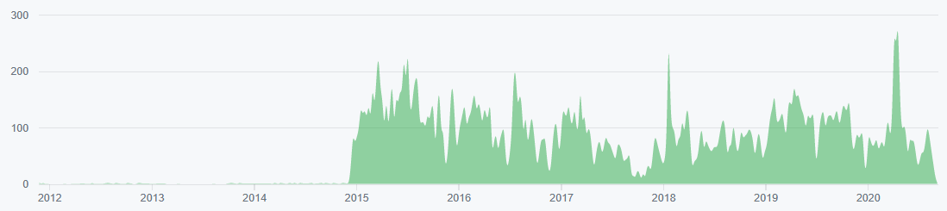
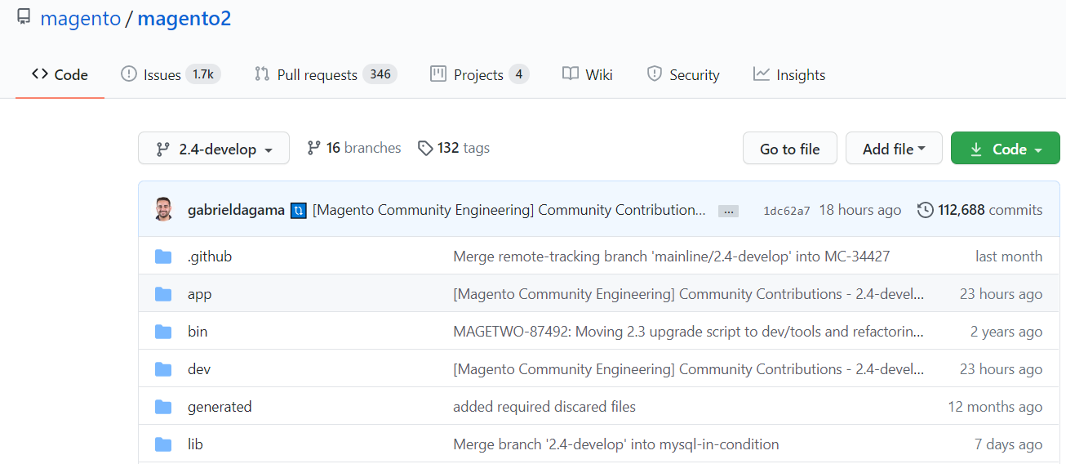
Motivation
Lot of contributors, community maintainers
Consistent recent activities
Expect more security threats
Open for contribution
open to take bug fixes, optimizations
new components or features
changes to existing features, tests
documentation (such as developer guides,
user guides, examples, or specifications)
or just good suggestions

Slide 7
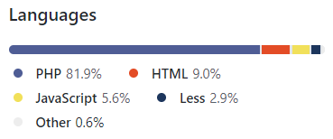
Language, License
License & contributor agreements
Open Software License(OSL) 3.0 or the Magento Enterprise Edition (MEE) license.

Slide 8
Threats perceived by users of the software in its intended operational environment?
Server Attacks
hackers install malware which affects the functionality of website and server’s data.
payment details are not at risk, but the security and reputation of eCommerce store will be damaged
Website Defacement
an attack aimed at spreading a message to highlight the poor security of a site or platform
user accounts might be compromised
Silent Card Capture
severe threat, have a potentially irreparable whack-on effect if allowed to compromise customer payment details
hackers install hidden malware or card capture software to extract the sensitive information like credit card details from consumers
Botnetting
malicious web attack that controls infected computers and sends out spam emails
customer data may not be at risk, but such servers can be blacklisted by spam filters

Slide 9
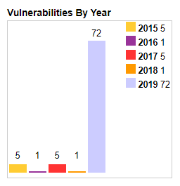
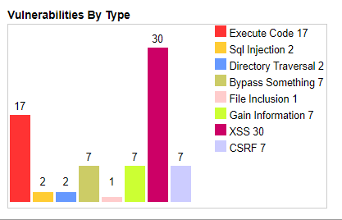
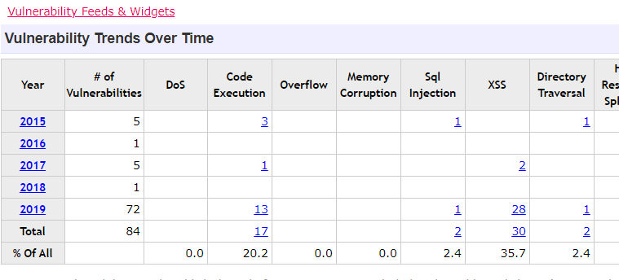
History of Issues
https://www.cvedetails.com/vendor/15393/Magento.html

Slide 10
Expected Attacks
Phishing
administrator account takeover, data leakage, identity theft and financial losses due to remedy activities
Ransomware
threatens retailers with disruption of web store operation,
customer sensitive information at risk of destruction or disclosure
Hacking an ecommerce admin panel
Having taken over administrator privileges, they get illicit control over the store operation and can interfere into catalog management, pricing, promotions, customer communication
Spamming
Jeopardize the reputation of a company if they hack its mail server and send spam emails on its behalf
(Latest finding by Astra reveals that 62% of a store has at least one vulnerability)

Slide 11
Security Measures
Dedicated teams to safeguard against Magento security threats, minimizing risks and resolving issues
Magento security patch to fix detected vulnerabilities
Security audits
identify potential vulnerabilities like missing security patches or configuration issues
Penetration testing
Testing team will attempt to attack a Magento application, server and network, and other potential points of exposure to detect possible security gaps
Magento Security Center
Safe environment
Protected file system
Protected admin panel
Reliable extensions
Incident response plan

Slide 12


Slide 13
Queries
Project Approval?
PHP
GitHub- security related issues
Code fixes
Project demand and challenge

